Slide 1
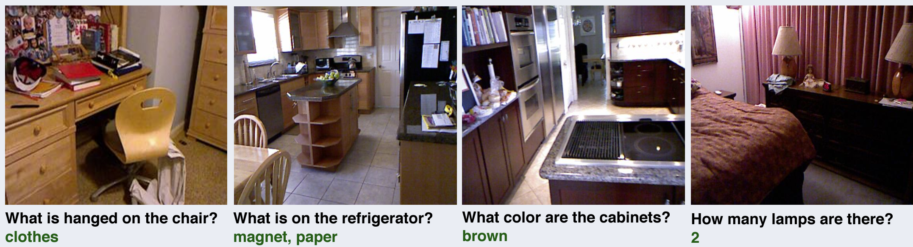
Visual Question Answering (VQA) Project
Implementation and Evaluation of Multimodal Transformers
Rishabh Singh
NUID : 002767904
Group : 26
CS 6120: Natural Language Processing
Instructor: Prof. Uzair Ahmad

Slide 2
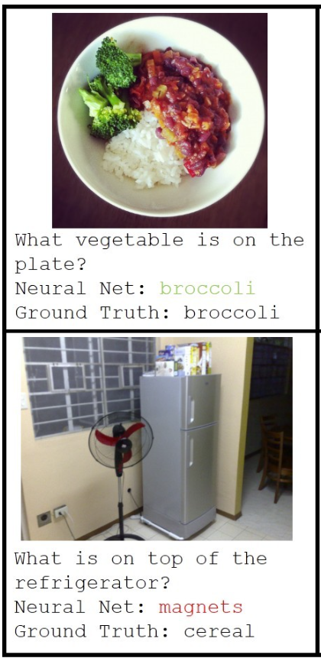
Introduction to VQA
What is VQA?
Multimodal task combining Natural Language Processing (NLP) and Computer Vision (CV).
Objective: Answer natural language questions based on an image.
Applications: Assistive technologies, Education and training, Autonomous systems

Slide 3
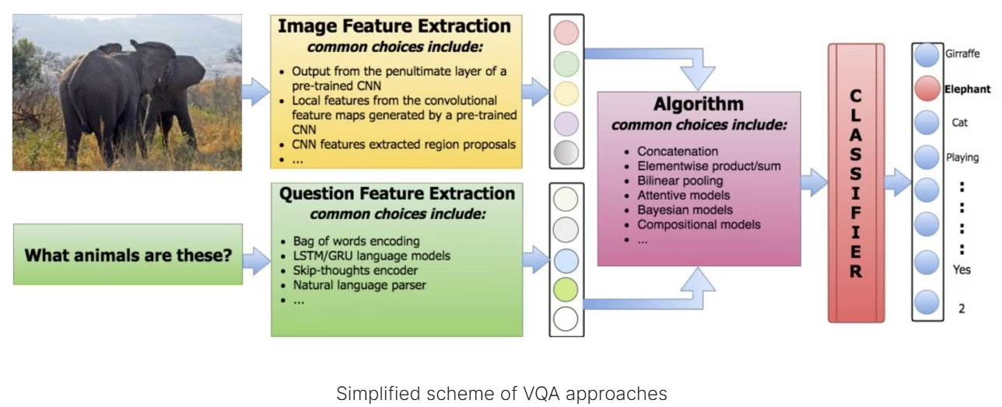
Project Objectives
Goals:
Explore feature extraction techniques using text and image transformers.
Implement late fusion-based multimodal architectures.
Evaluate using metrics like accuracy, macro F1, and WUPS.

Slide 4
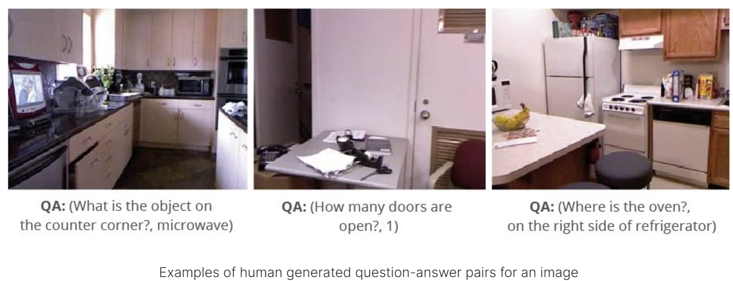
DAQUAR Dataset Overview
Indoor images : ~12,500 question-answer pairs based on NYU-Depth V2 images.
Custom Data Splits: Training (80%), Evaluation (20%)
1449 RGBD images
12.5k Image-Question-Answer triples
- Around 9 QA pairs per image
Questions about objects, set of objects, colors, numbers, and sizes of the objects
Subjectivity is dominant in the dataset
- Spatial relations exhibit different reference frames
- Same objects are referred by multiple names
- Night stand, stool, cabinet
- Subjective objects saliency

Slide 5
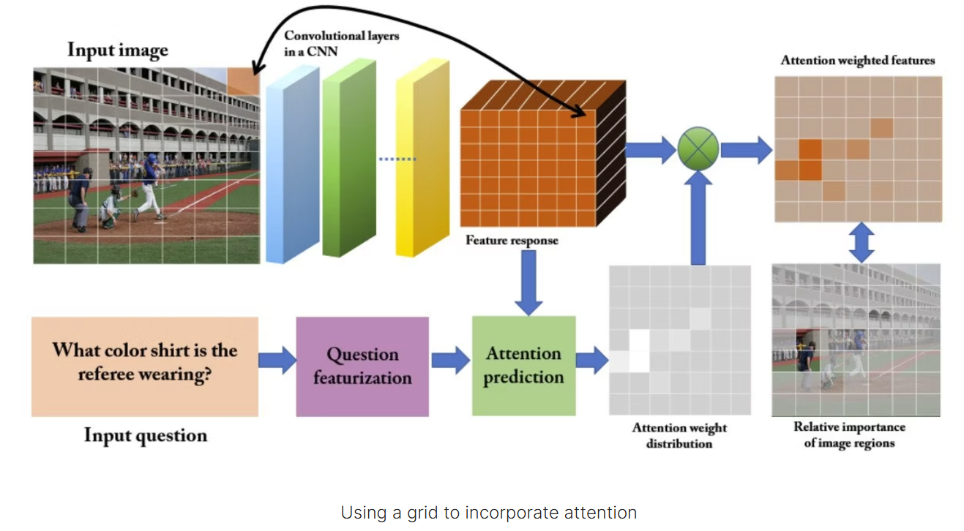
Methodology
Steps:
1. Feature extraction from images and text.
2. Multimodal feature fusion.
3. Answer prediction modeled as multiclass classification.
Tools: PyTorch, Hugging Face Transformers, NLTK, Scikit-learn.

Slide 6
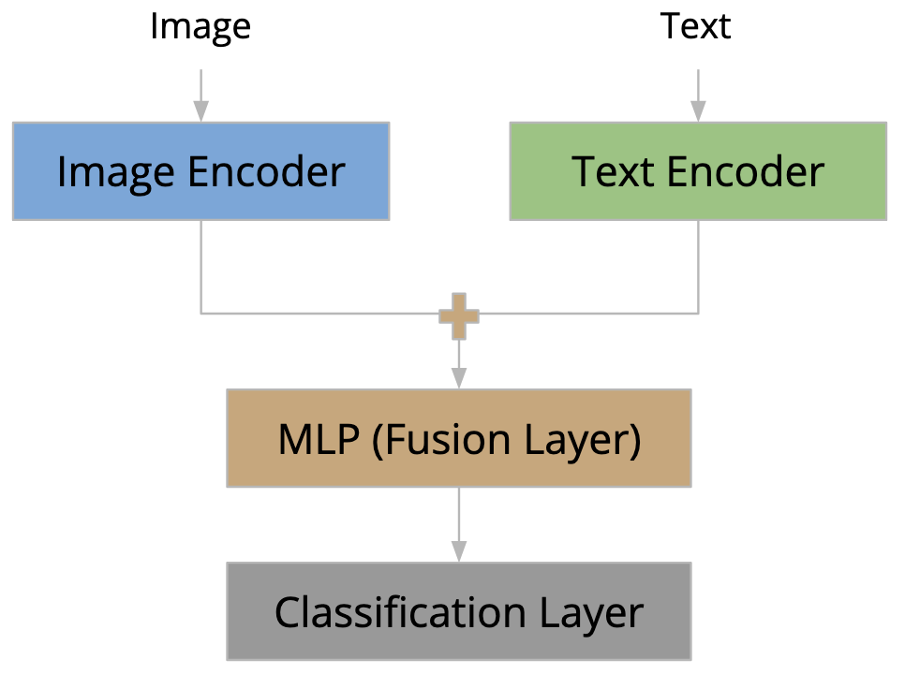
Method 1: VQA Classification (BERT + ViT)
Architecture:
- BERT: Text encoder for questions.
- ViT: Visual encoder for image features.
- Fusion Layer: Concatenates text and image features.
- Classifier: Predicts the most probable answer.

Slide 7
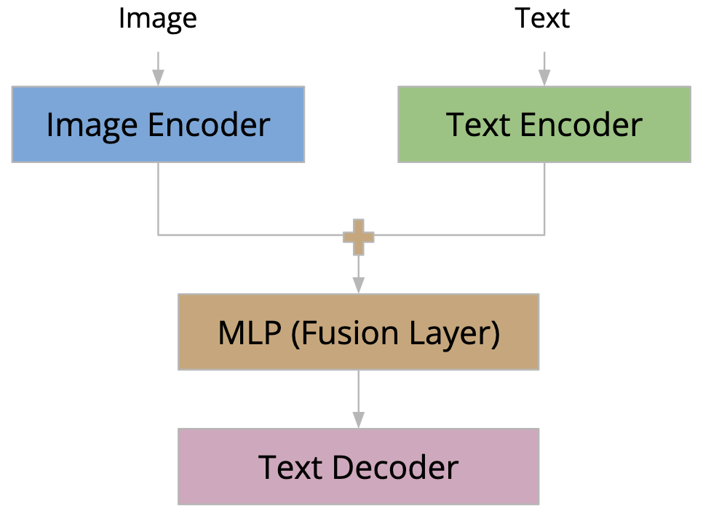
Method 2: VQA Generation (BERT + ViT) Encoder + (GPT2) Decoder
Architecture:
- BERT + ViT: Encoders for text and image inputs.
- GPT: Decoder for generating textual answers.
- Workflow: Tokenize text, encode image, use GPT decoder.

Slide 8
Comparison of VQA Classification and VQA Generation
Key Differences:
Classification: Fixed answer space, faster inference.
Generation: Open-ended answers, generates sequences.

Slide 9
Evaluation Metrics
Metrics Used:
Accuracy: Percentage of correct answers.
Macro F1 Score: Balances precision and recall.
Wu and Palmer Similarity (WUPS): Measures semantic similarity.

Slide 10


Results and Observations
BERT + ViT: Good performance with moderate complexity, with a WUPS score of 0.26and eval loss of 3.76, eval accuracy of 0.21, eval f1 of 0.018.
BERT + ViT + GPT2: Highest WUPS and accuracy due to robust embeddings, with aWUPS score of 0.27 and eval loss of 3.72, eval accuracy of 0.22, eval f1 of 0.018.
Key Insights: Robust text embeddings, ViT excels in visual tasks.

Slide 11
Limitations
Challenges: Long training time.
Limited dataset size (DAQUAR).
High computational requirements.
Semantic metrics lack sentence-level coverage.

Slide 12
Future Directions
Transfer learning on larger datasets.
Incorporating external knowledge graphs.
Optimizing model efficiency for real-world applications.

Slide 13
Conclusion
Implemented VQA using multimodal transformers.
Explored classification and generation models.
Potential for broader applications.

